Slide 1
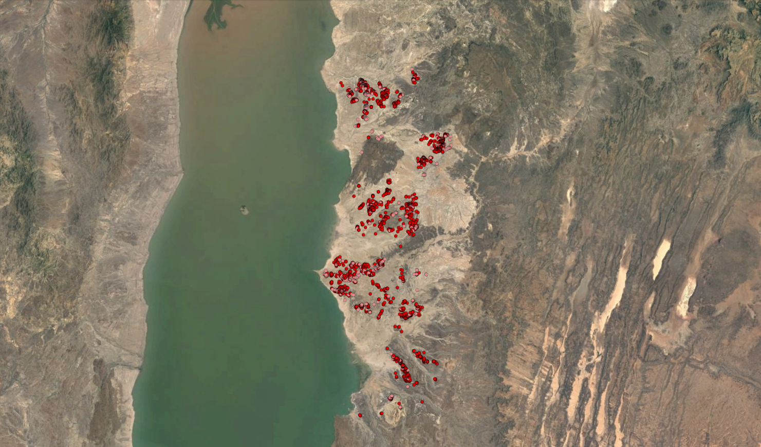
Testing machine learning approaches for remote fossil site detection at Koobi Fora
João d’Oliveira Coelho, 2018

Slide 2
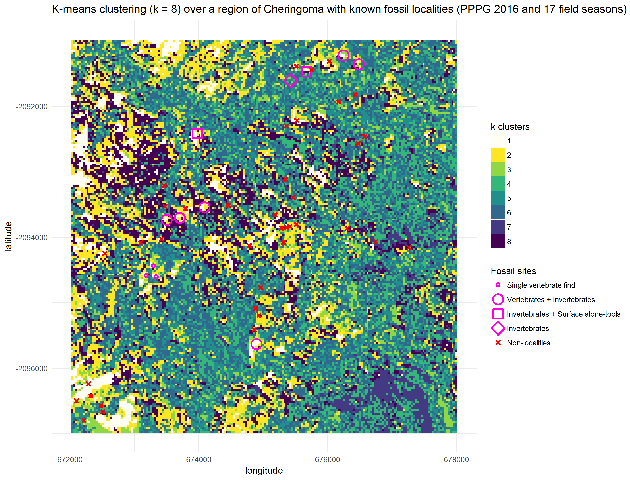
Some previous examples from Gorongosa

Slide 3
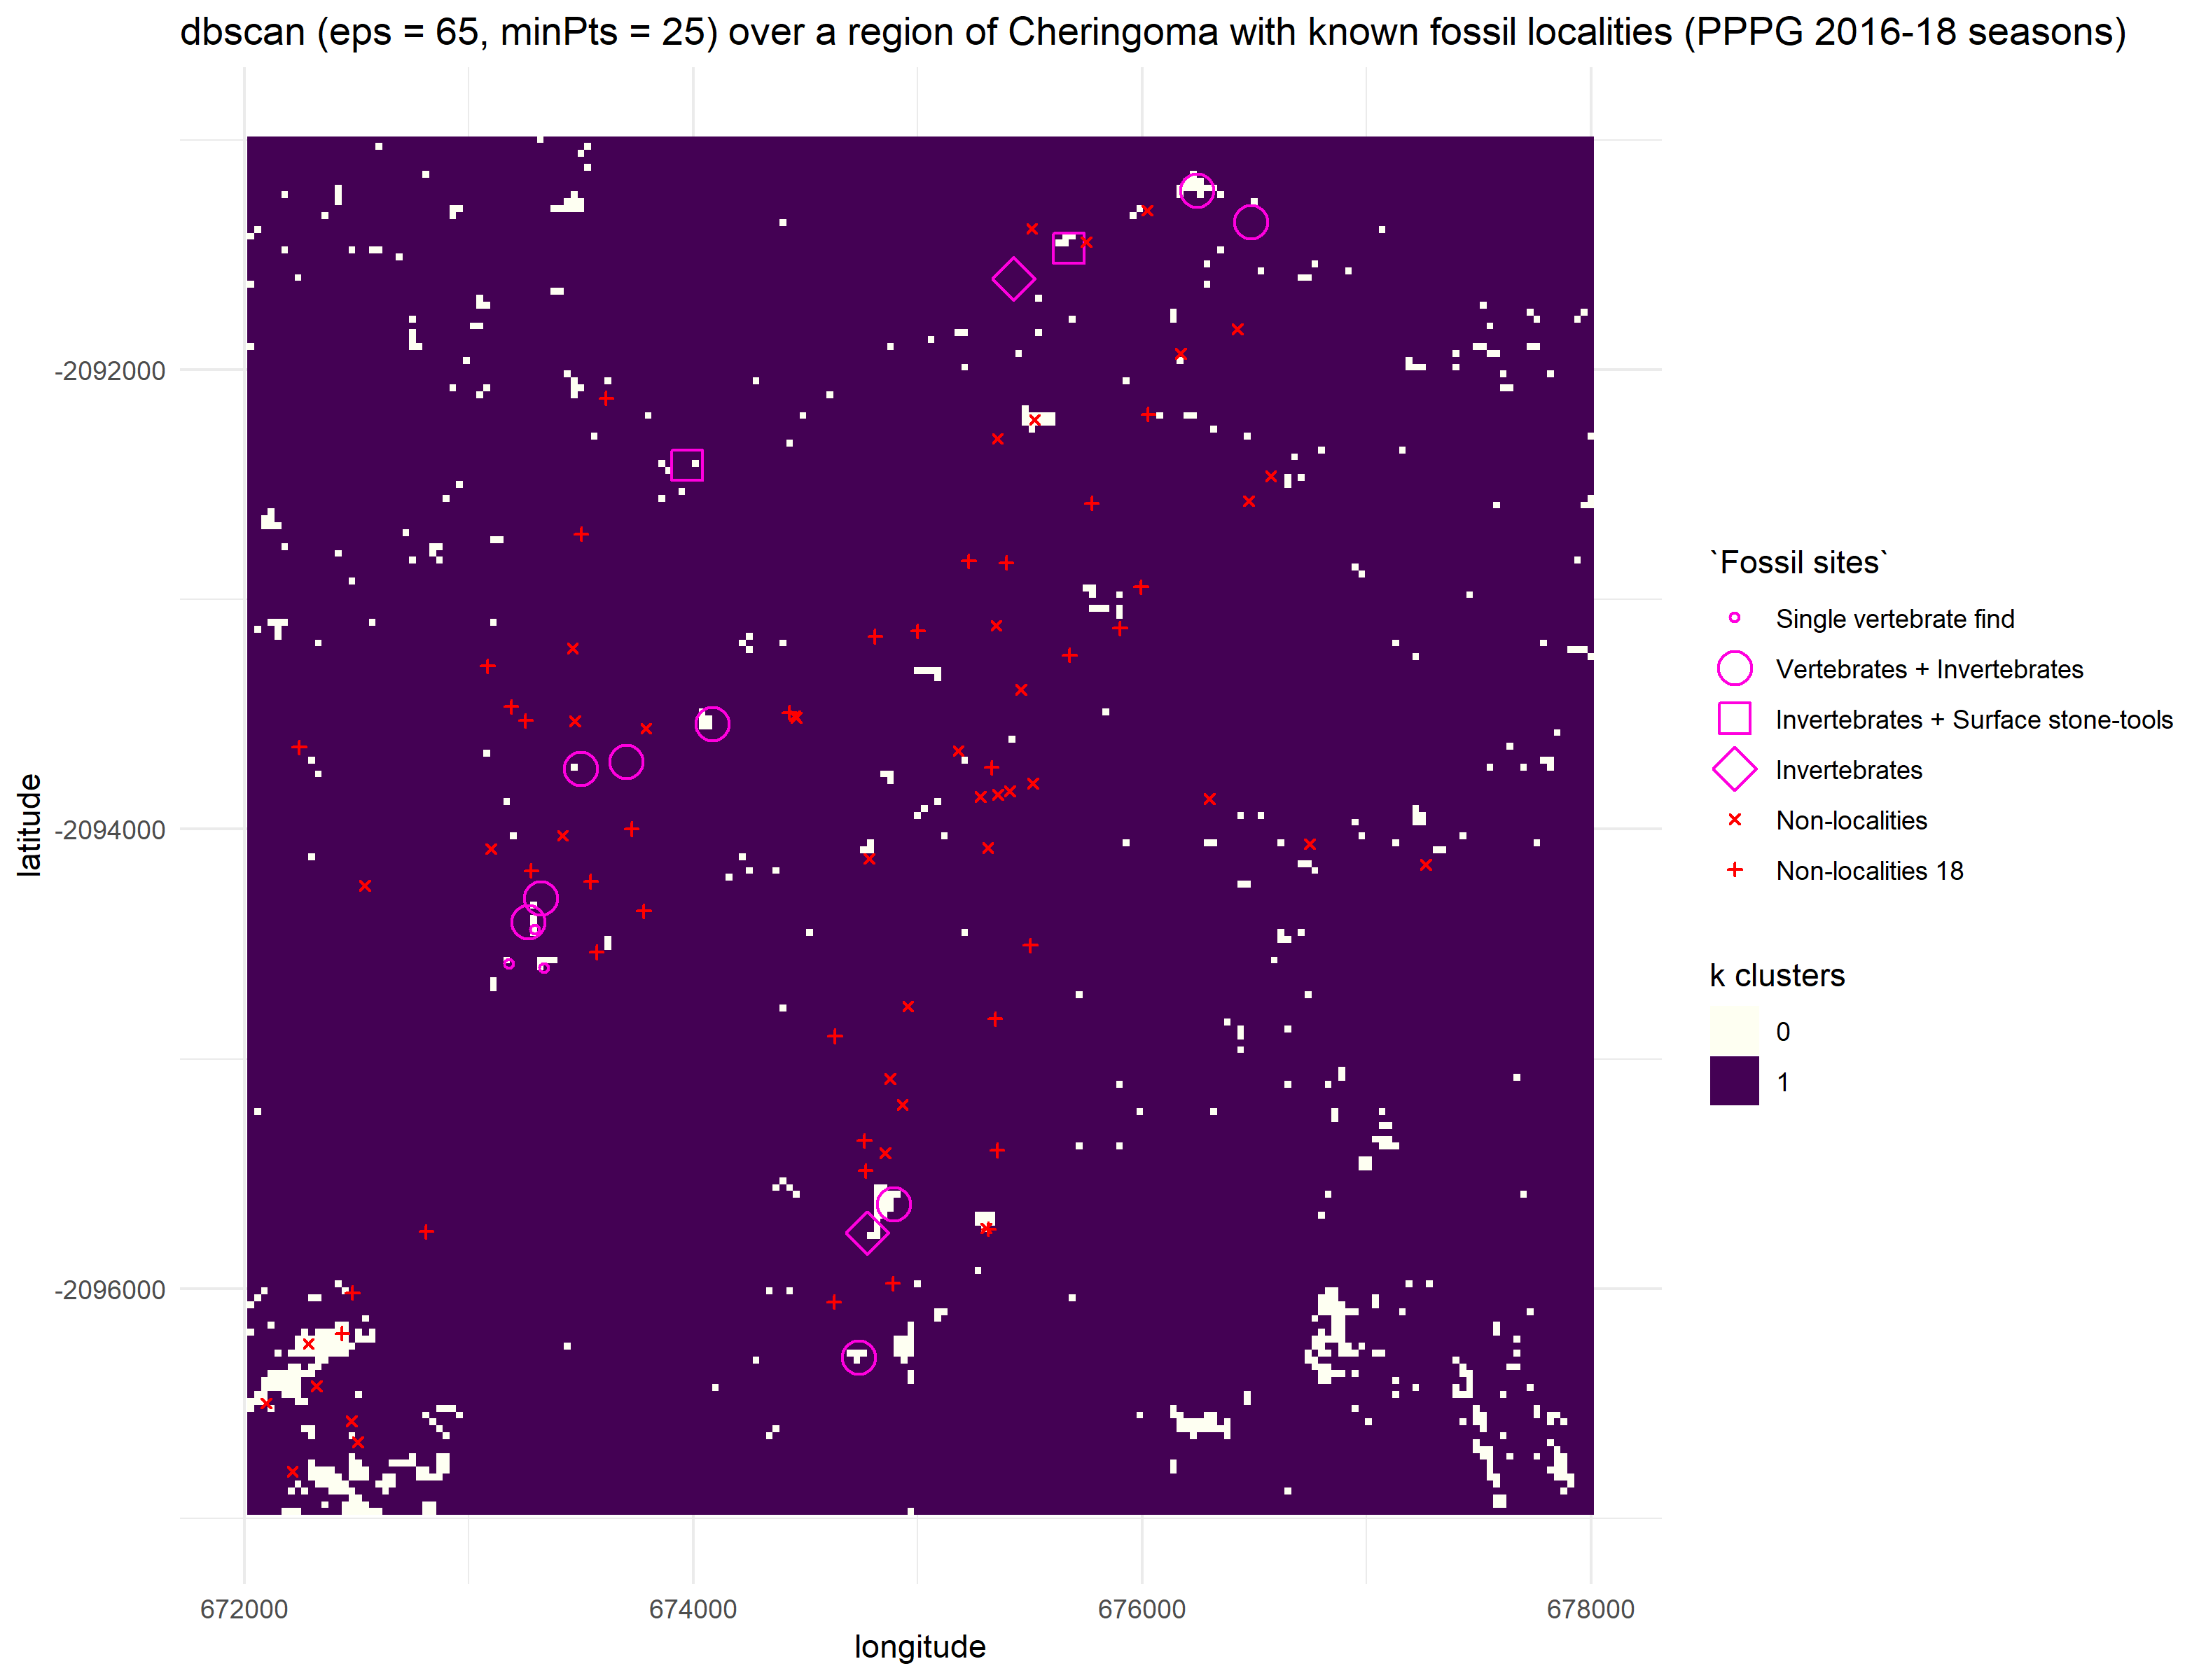
Some previous examples from Gorongosa
dbscan: Density-based spatial clustering of applications with noise

Slide 4
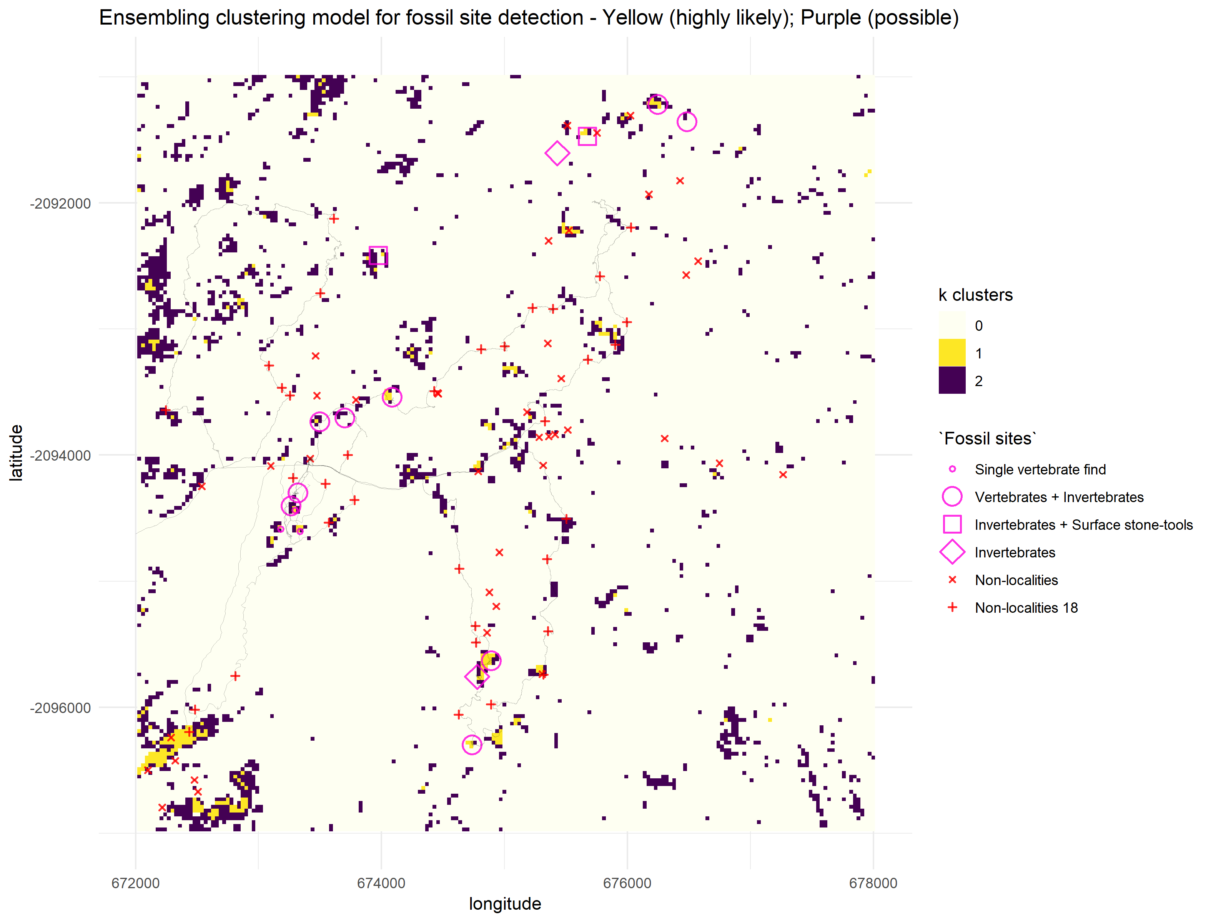
Some previous examples from Gorongosa

Slide 5
Koobi Fora: one-class classification
Similar to binary classification in statistics
But it works when you only have positive data (e.g. fossil sites)
So, instead of a 1 vs 0 problem you have a 1 vs NA (or positive vs unlabelled)
This avoids laborious tasks from multiclass classification (e.g. manually labelling landcovers as grassland, wetland, scrubland, forest, roads, rivers, lakes, etc.) and theoretically dubious approach (how can we be sure that any type of landcover is certainly unfossiliferous!?)
No assumptions about “negative classes”. It lets the data talk!

Slide 6
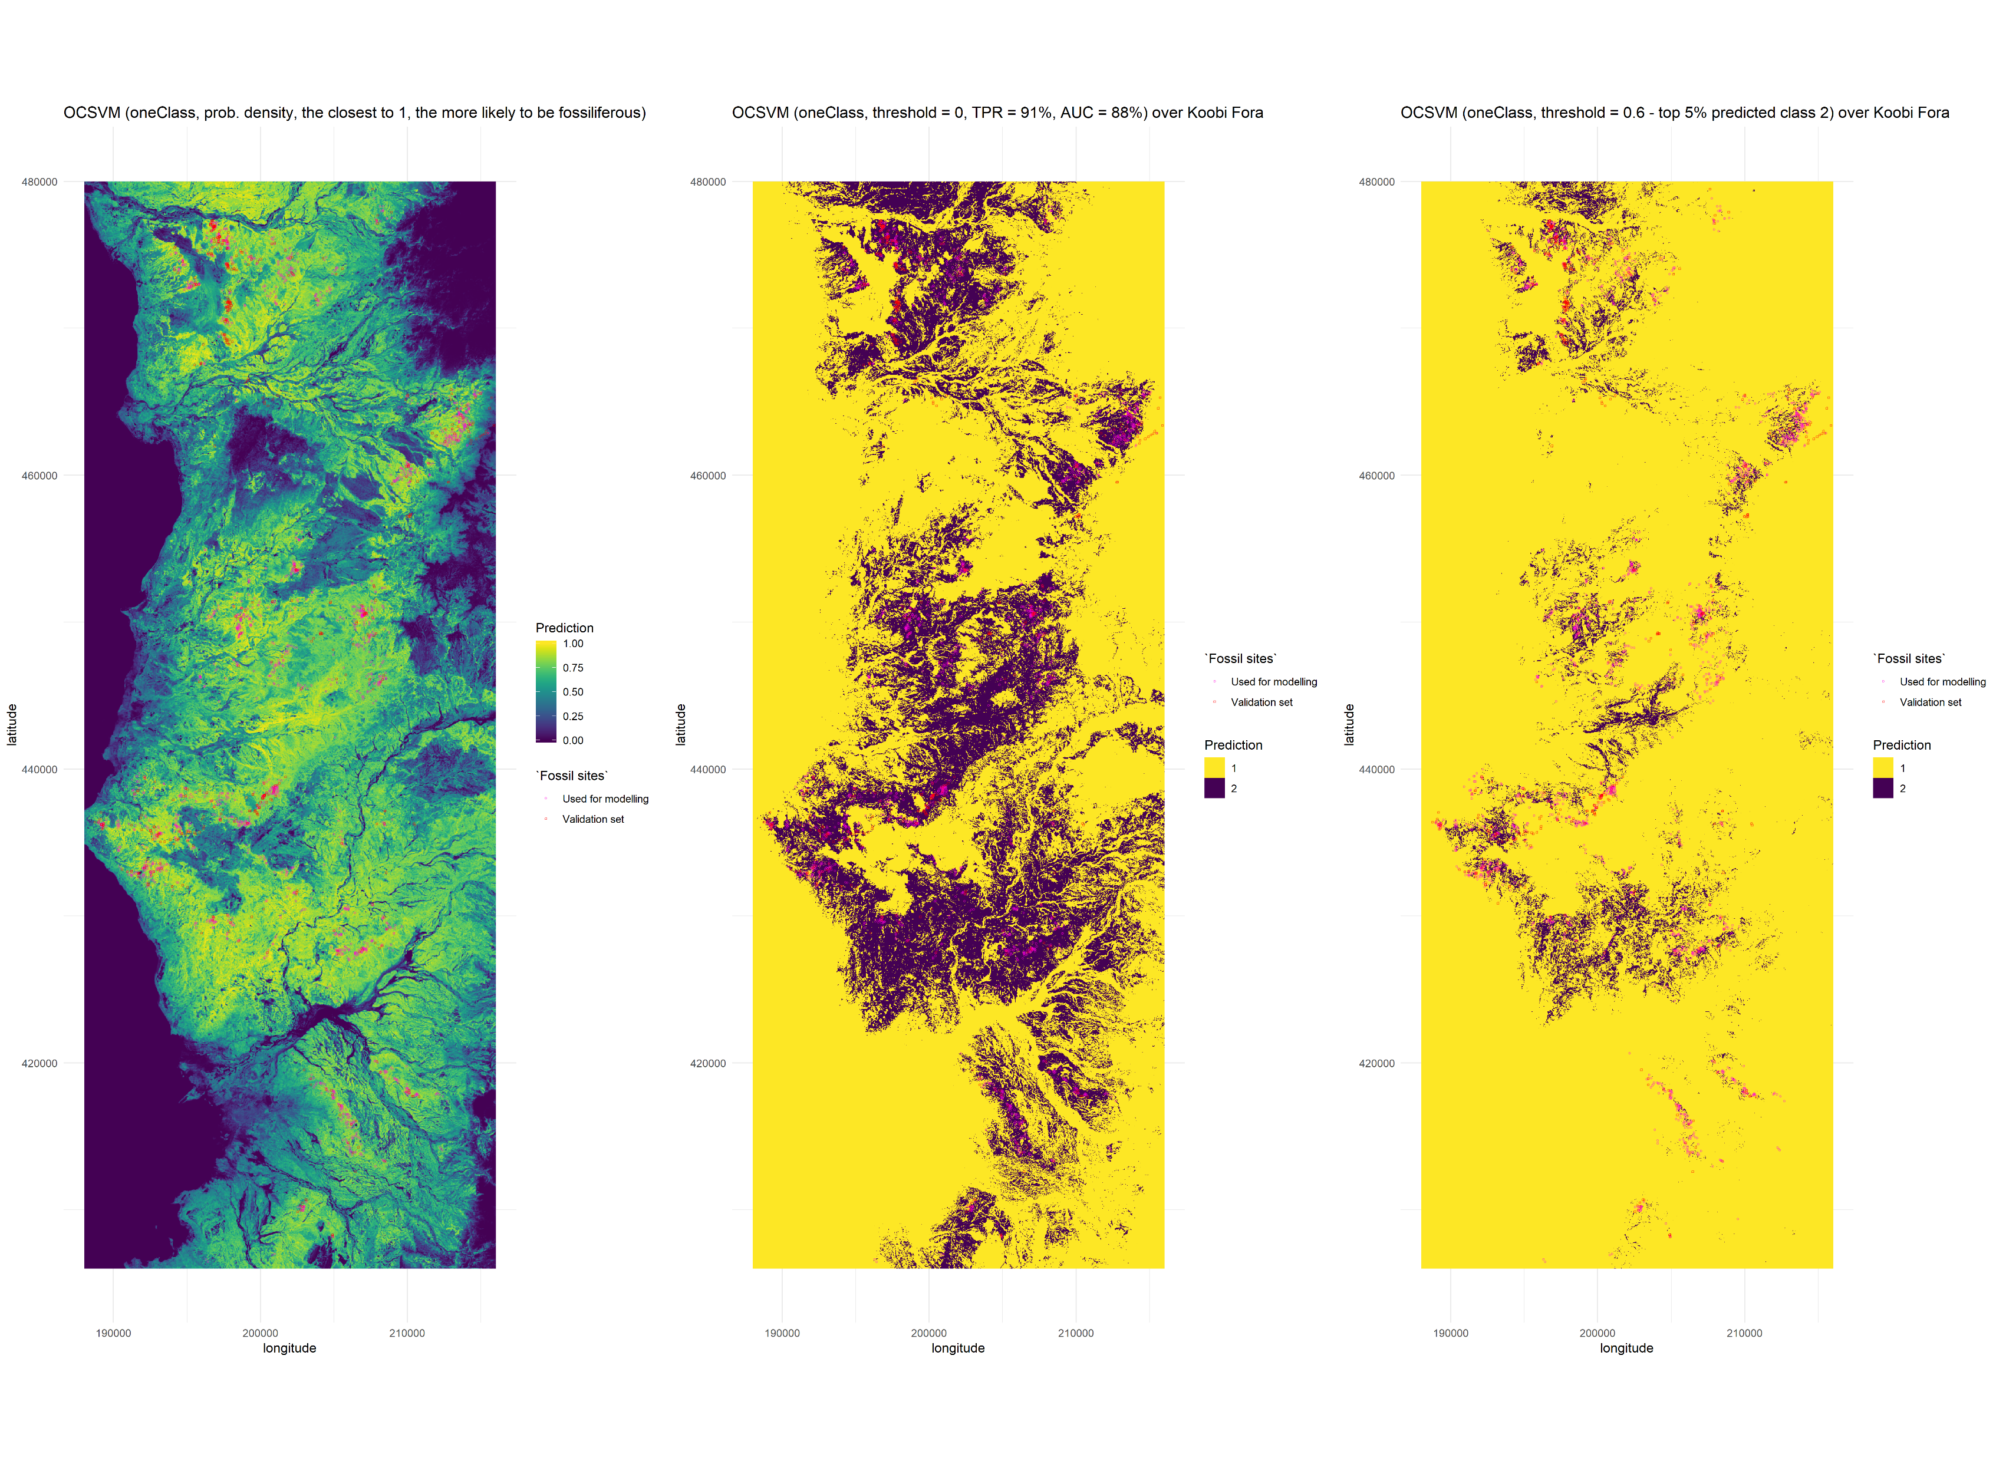
ZOOM!

